Slide 1
Quantity Theory of Money
Principles of Macro Economics 2
ECONA 202

Slide 2
Fisher’s Equation
According to Fisher, as the quantity of money in circulation increases the other things remain unchanged. The price level also increases in direct proportion as well as the value of money decreases and vice-versa. Fisher's theory can be best explained with the help of a famous equation i.e., MV = PT or P = MV/T.

Slide 3
Like other commodities, the value of money or the price level is also determined by the demand and supply of money.
i. Supply of Money:
The supply of money consists of the quantity of money in existence (M) multiplied by the number of times this money changes hands, i.e., the velocity of money (V). In Fisher’s equation, V is the transactions velocity of money which means the average number of times a unit of money turns over or changes hands to effectuate transactions during a period of time.
Thus, MV refers to the total volume of money in circulation during a period of time. Since money is only to be used for transaction purposes, total supply of money also forms the total value of money expenditures in all transactions in the economy during a period of time.
ii. Demand for Money:
Money is demanded not for its own sake (i.e., for hoarding it), but for transaction purposes. The demand for money is equal to the total market value of all goods and services transacted. It is obtained by multiplying total amount of things (T) by average price level (P).
Thus, Fisher’s equation of exchange represents equality between the supply of money or the total value of money expenditures in all transactions and the demand for money or the total value of all items transacted.

Slide 4
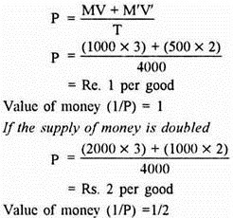
Example:
Fisher’s quantity theory of money can be explained with the help of an example. Suppose M = Rs. 1000. M’ = Rs. 500, V = 3, V’ = 2, T = 4000 goods.
.

Slide 5
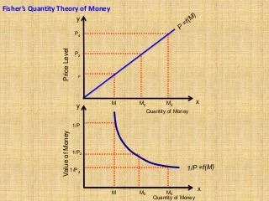

Slide 6

This Photo by Unknown Authoris licensed under CC BY-NC

